Slide 1
Amazon Marketplace
Category - Diapering
Group 5
-Geoffrey, Stephane & Nicole

Slide 2
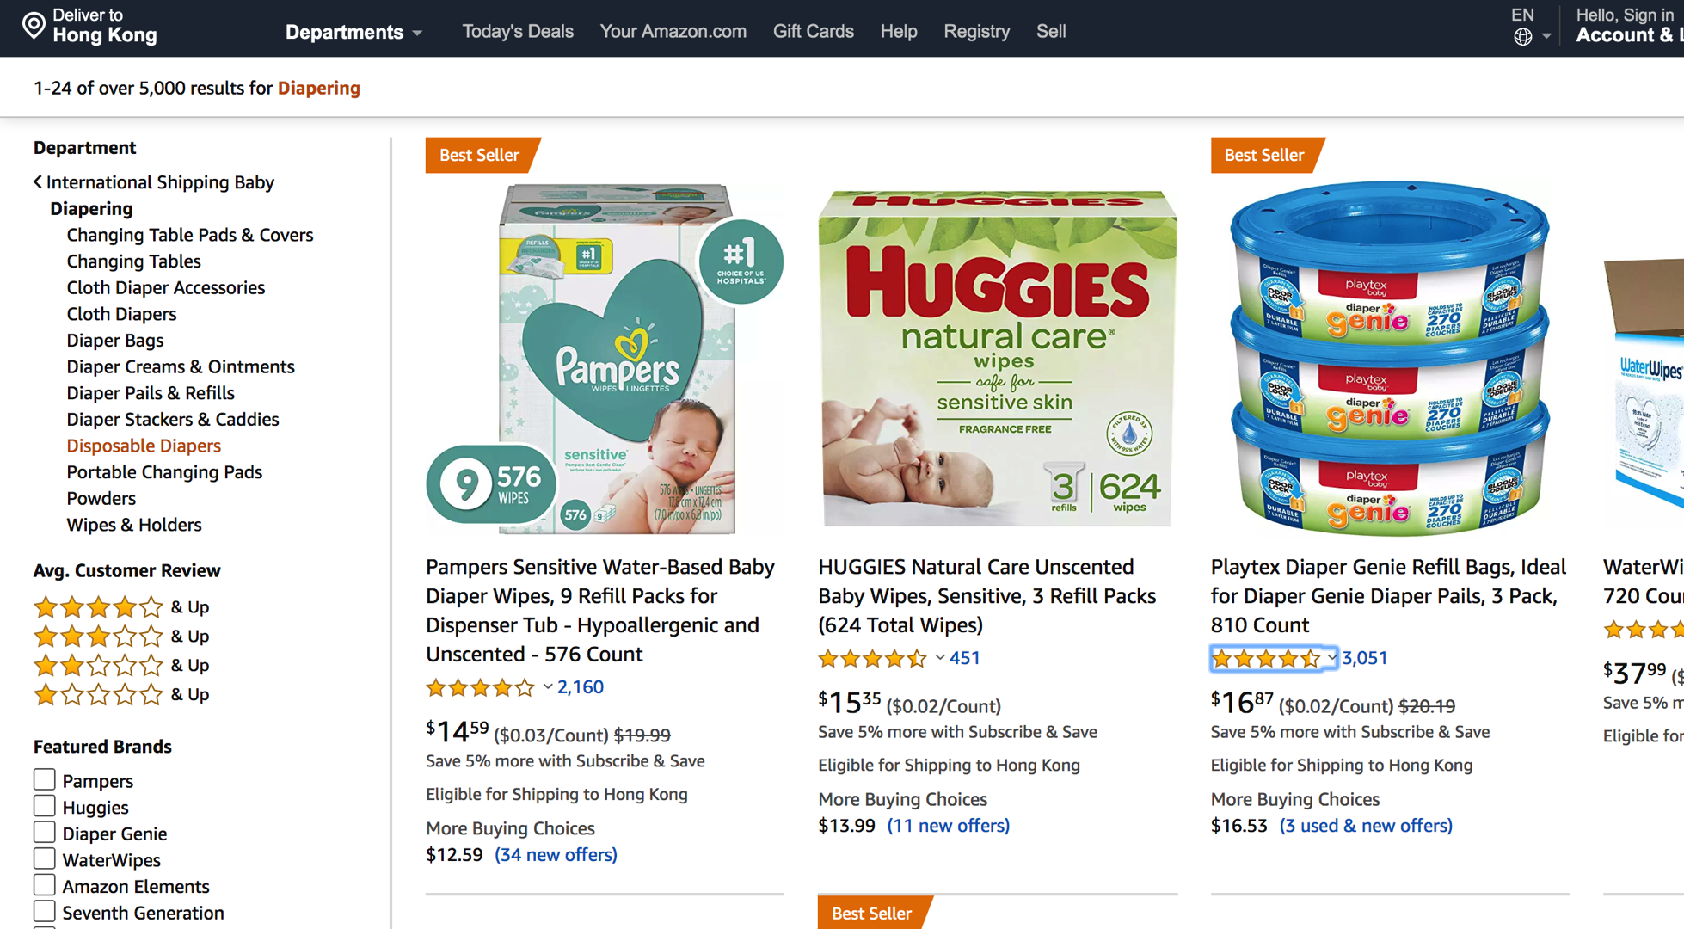
Disposable Diapers

Slide 3
Aims & Methodology
Get insight into the disposable diaper marketplace in Amazon site
BeautifulSoup to scrap data from website
Regex to clean data to get the information wanted
-brand name, rating, number of reviews and price
Any relationship and correlations between them?

Slide 4
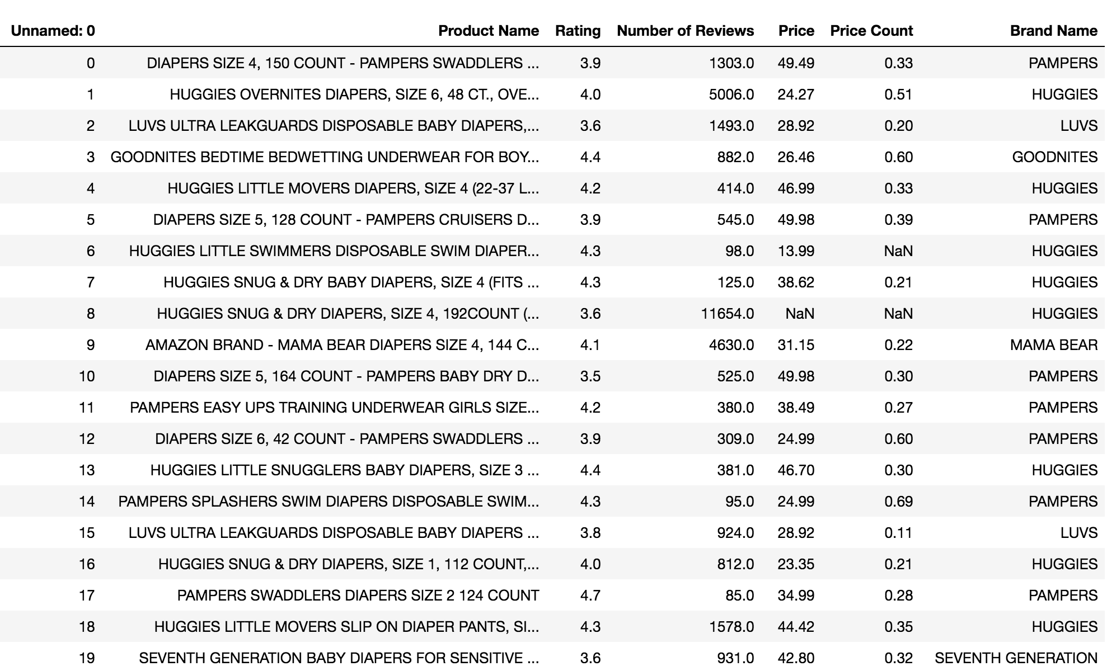
DataFrame

Slide 5
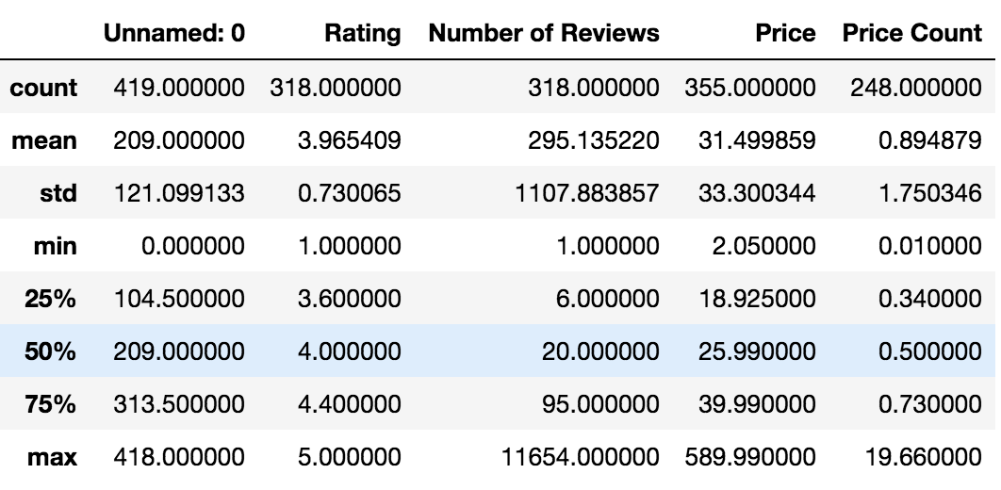
Statistics

Slide 6
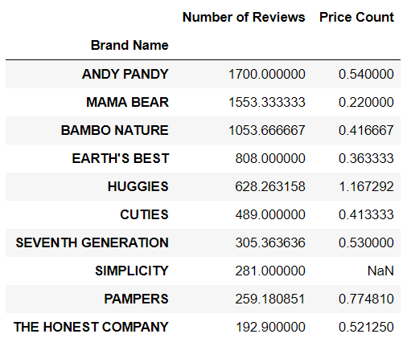
Number of reviews per product

Slide 7
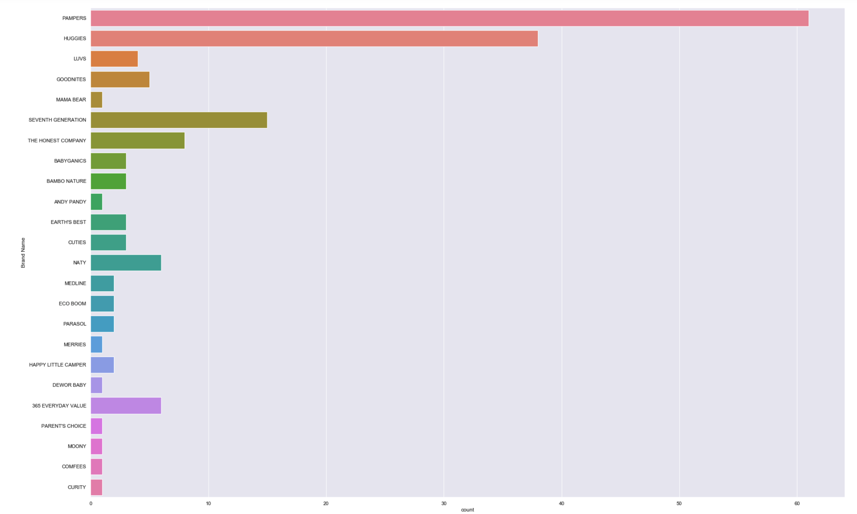
Number of products by Brand

Slide 8
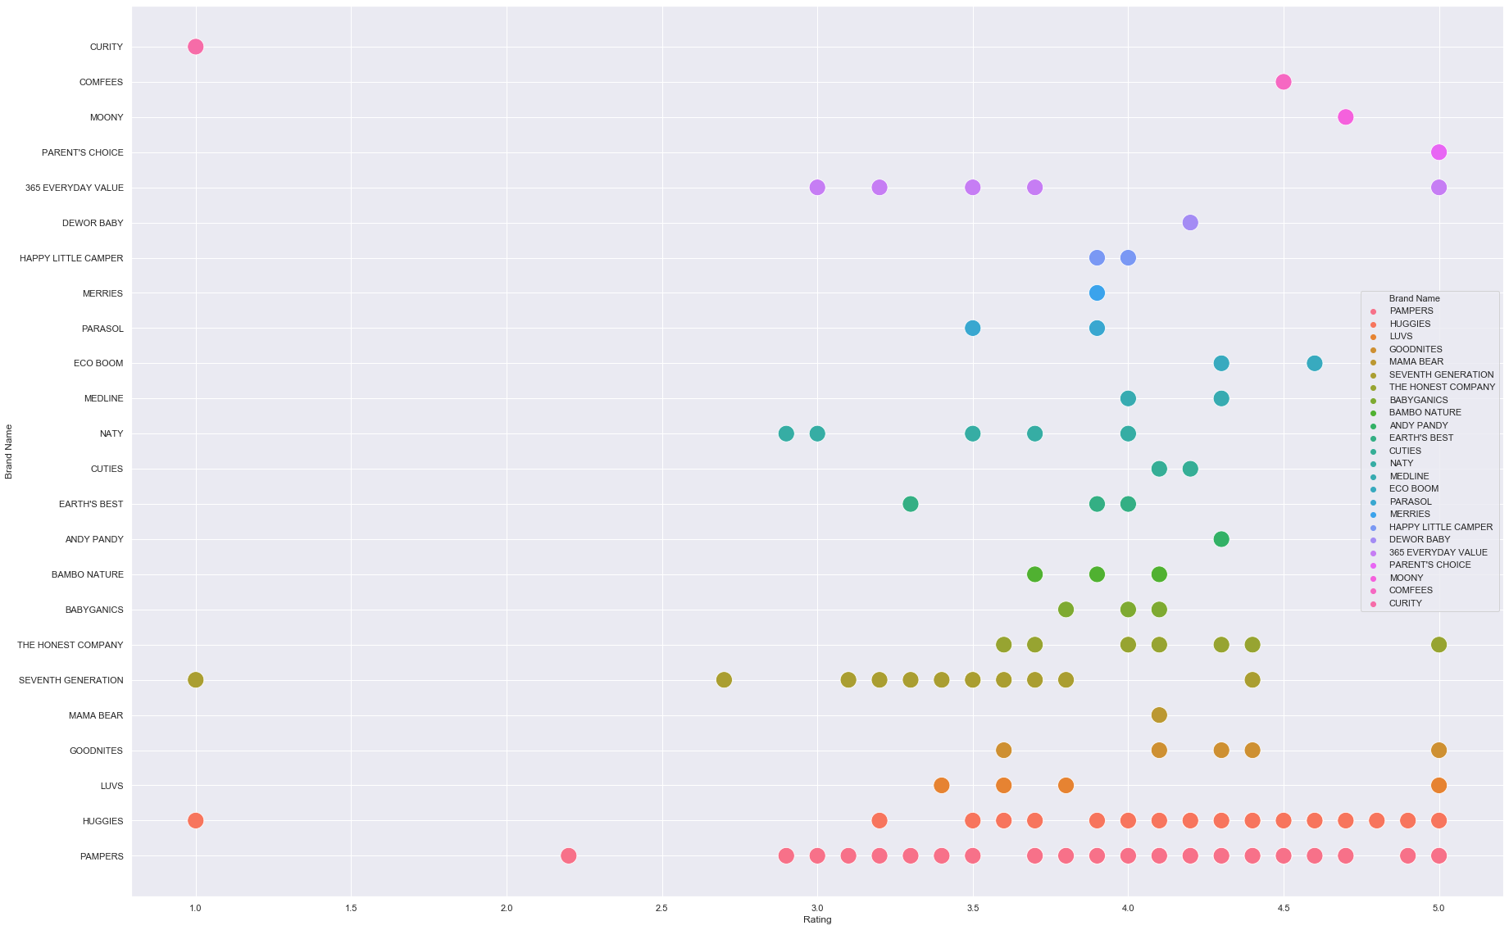
Brand vs. Rating

Slide 9
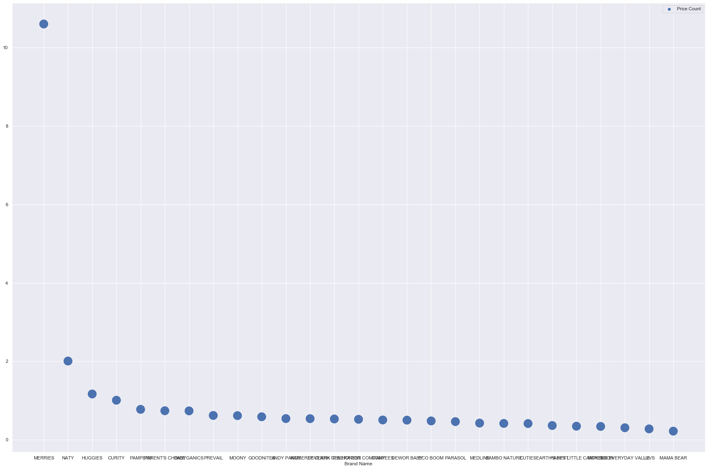
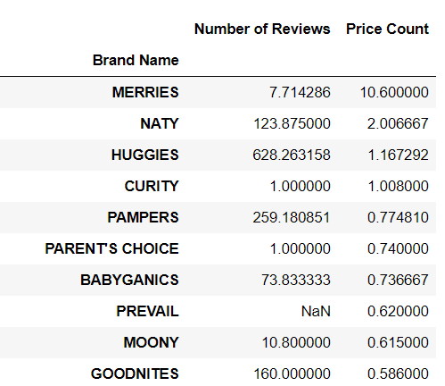
Top Price by Brand

Slide 10
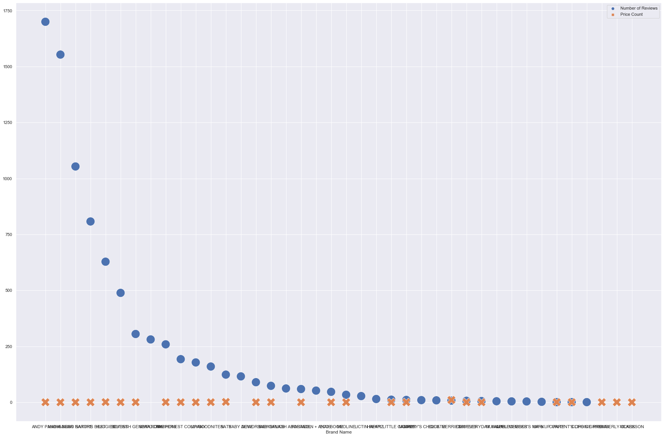

Price Count vs. no.of.Reviews

Slide 11
Issues & Solutions
Some products may not have reviews/ ratings and price
Different way of naming products
Some data are not given properly from the website
Different data type in the objects which cannot be used in Seaborn

Slide 12
Potential Improvement Of The Data Set
Increase the size of data set e.g. by including other types of diapering
Beautify the graphs

Slide 13



Conclusion
3 top brands which have the most number of products available
These 3 top brands not necessary have the highest rating

